Slide 1

SOS – SAFE OUR SOCIETY
COVID FREE COMMUNITY

Slide 2
Team Members:
Kowsika Palanisamy
Dhivya Shree Rengaraj
Azhageswaran Raja
Priya Dharsini Baskar
Dharanya Moorthy

Slide 3
ABSTRACT :
During this Covid Situation, Hospitals are struggling to manage
the patients by providing necessary service at the right time.
By Overcoming the above situation, We created a simple web application that would help the patients to view which hospital
having enough bed and oxygen cylinder availabilities.
So that we can save precious time and life of our patients.

Slide 4
OBJECTIVE:
It is a project that the user can able to view the availability of doctors, beds and oxygen cylinders.
They can also made their request for booking the available resources.
It helps the staff and management by reducing the time of counting and recording the availability of beds and oxygen cylinders.

Slide 5
Modules:
1.Admin Module
2.User Module
3.Doctor Module

Slide 6
Functions of Admin Module
Add the details of bed, oxygen
2. Update the hospital details.
3. Delete the hospital details.
4. Search the hospital by id, name.
5.View the doctors working in a particular hospital.

Slide 7
Attributes of Admin Module:
hospitalId
hospitalName
address
pincode
bedAvailability
oxygenAvailability

Slide 8
Functions of User Module:
1.User can view all hospitals
2.View the Oxygen and Bed Availabilities
3.Register for bed and oxygen

Slide 9
Attributes of User Module
userId
username
password
age
email
gender
mobileNumber
bloodGroup

Slide 10
Functions of Doctor Module
Doctor can update their status
Edit their Profile

Slide 11
Attributes of Doctor Module
doctorId
doctorName
hospitalId
hospitalName
doctorStatus
qualification

Slide 12
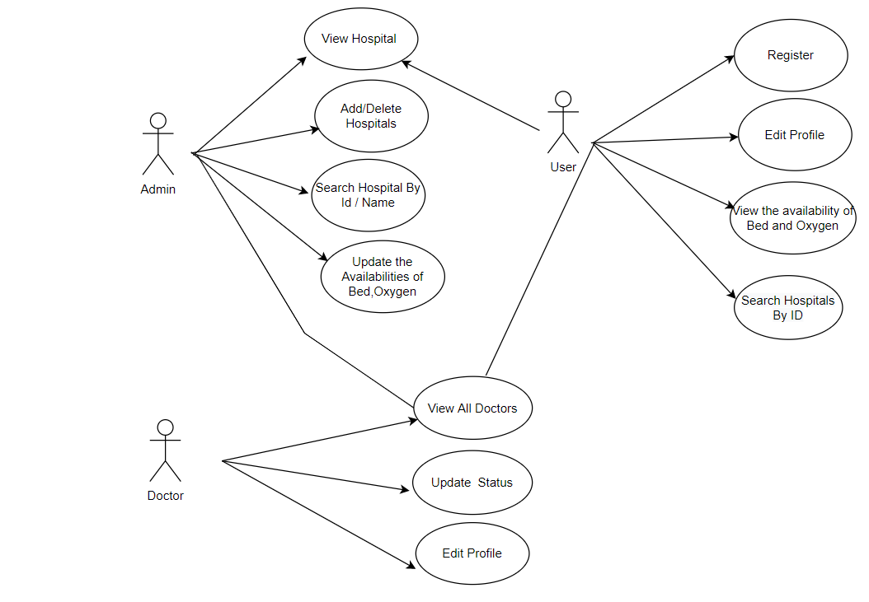

Slide 13
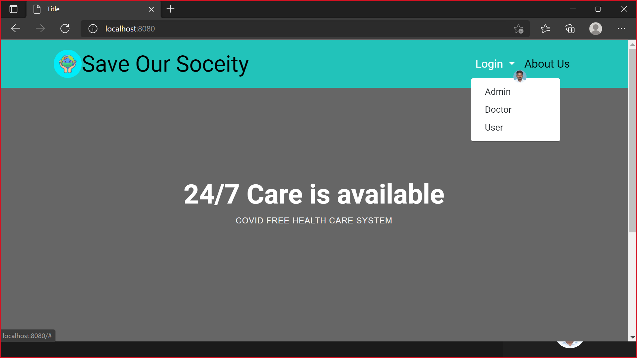

Slide 14
ADMIN MODULE

Slide 15
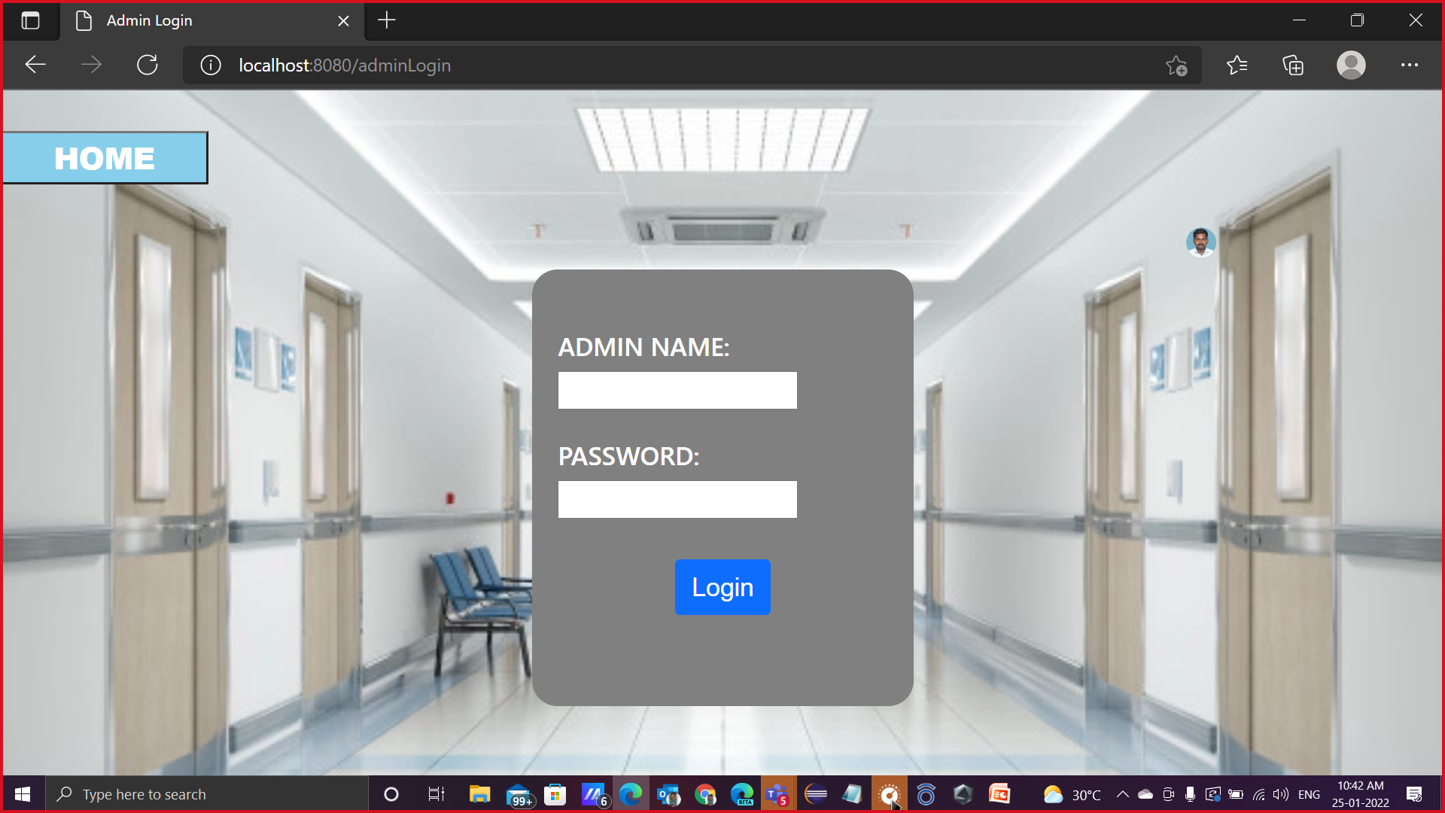

Slide 16
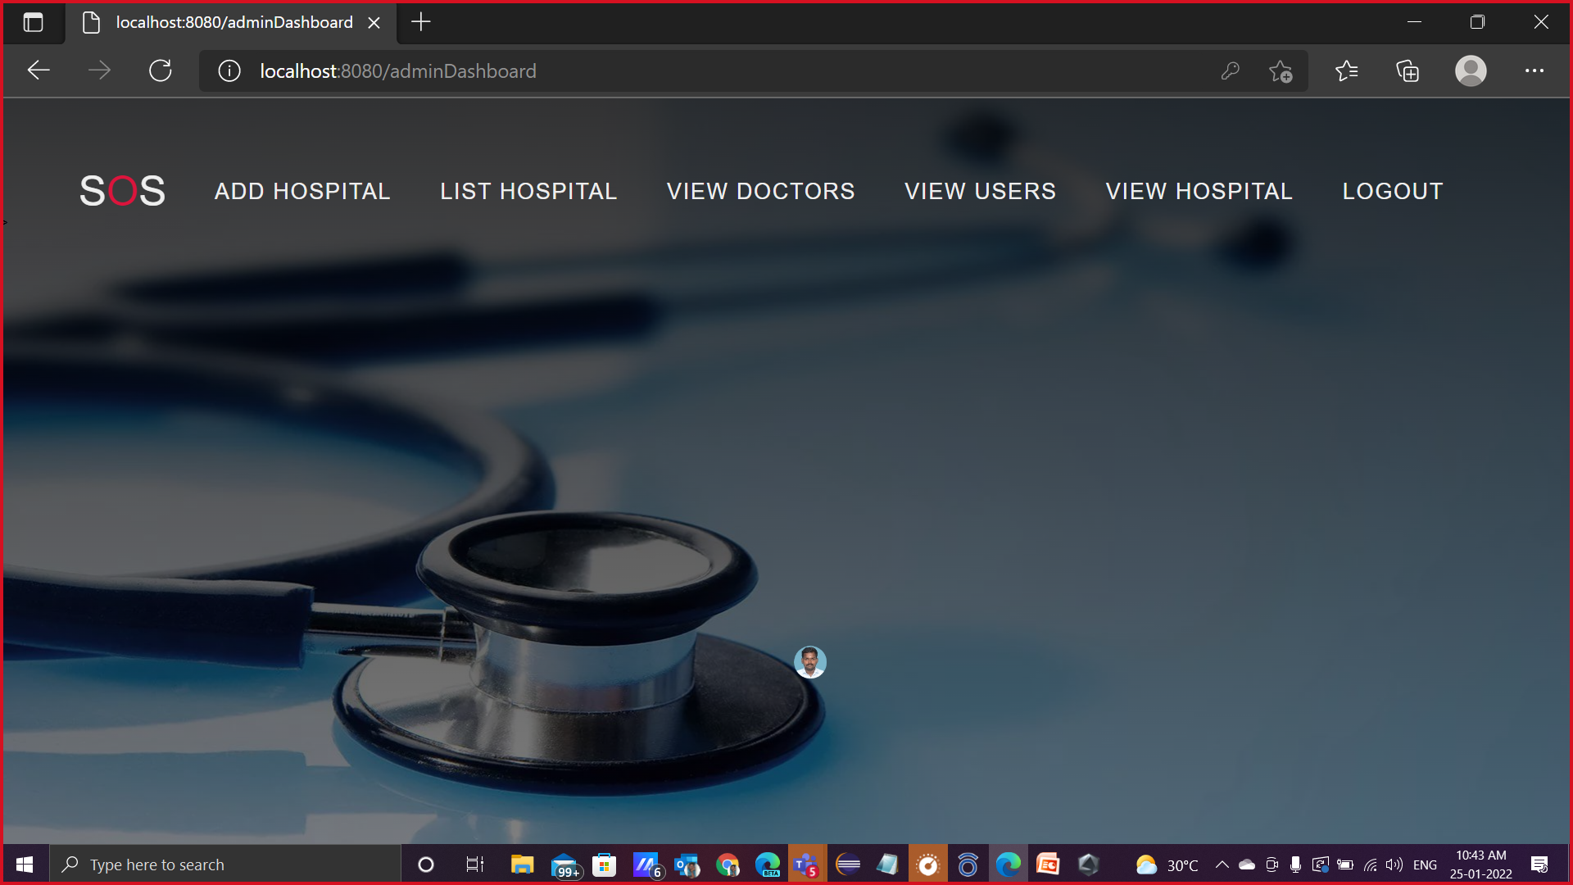

Slide 17
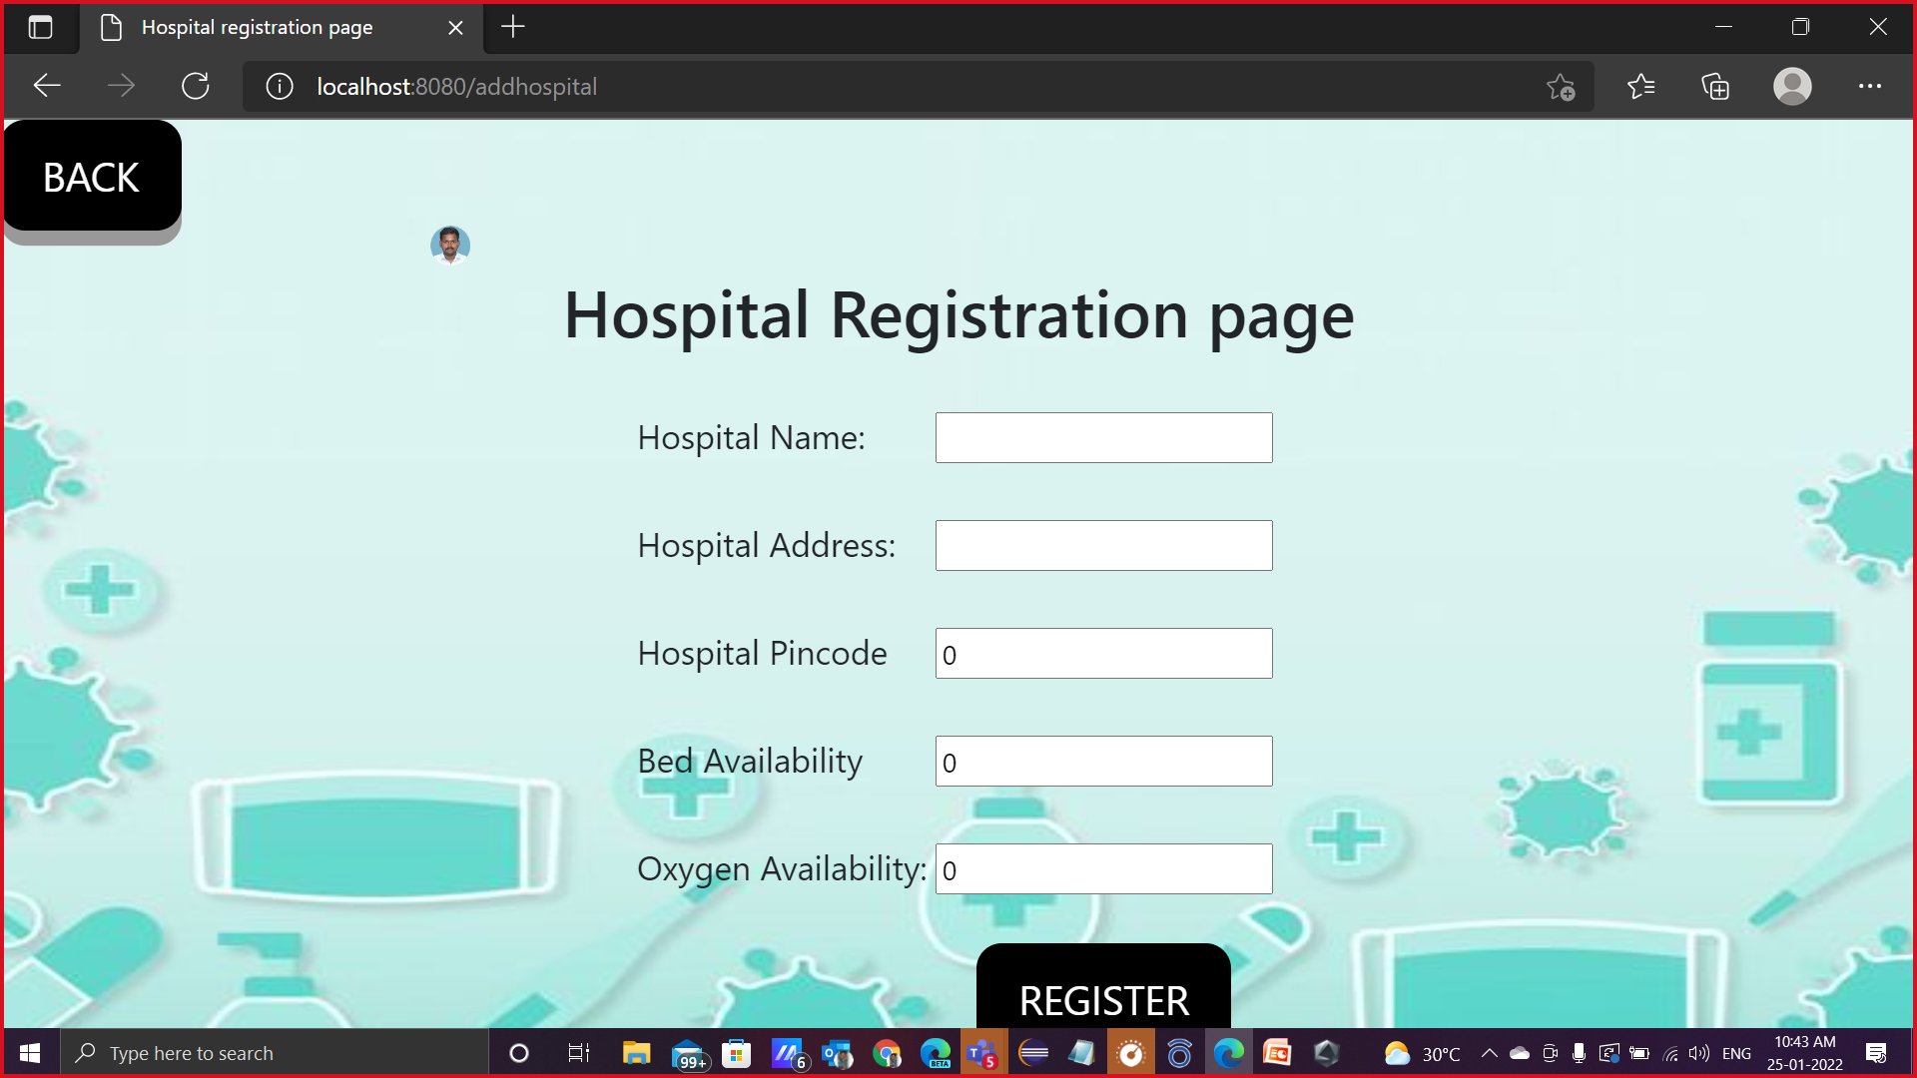

Slide 18
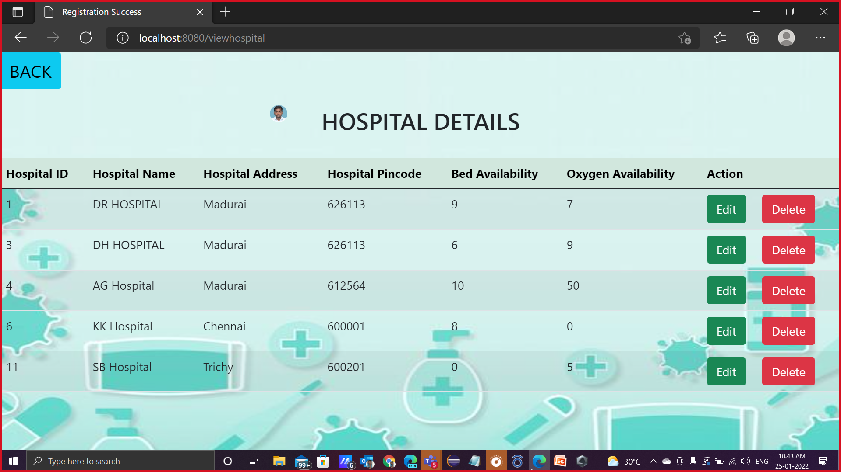

Slide 19
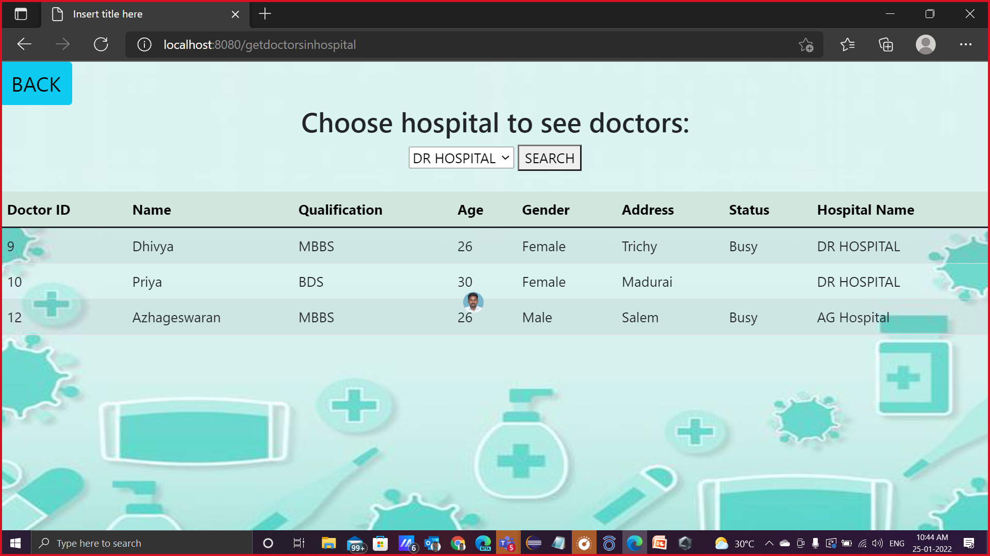

Slide 20
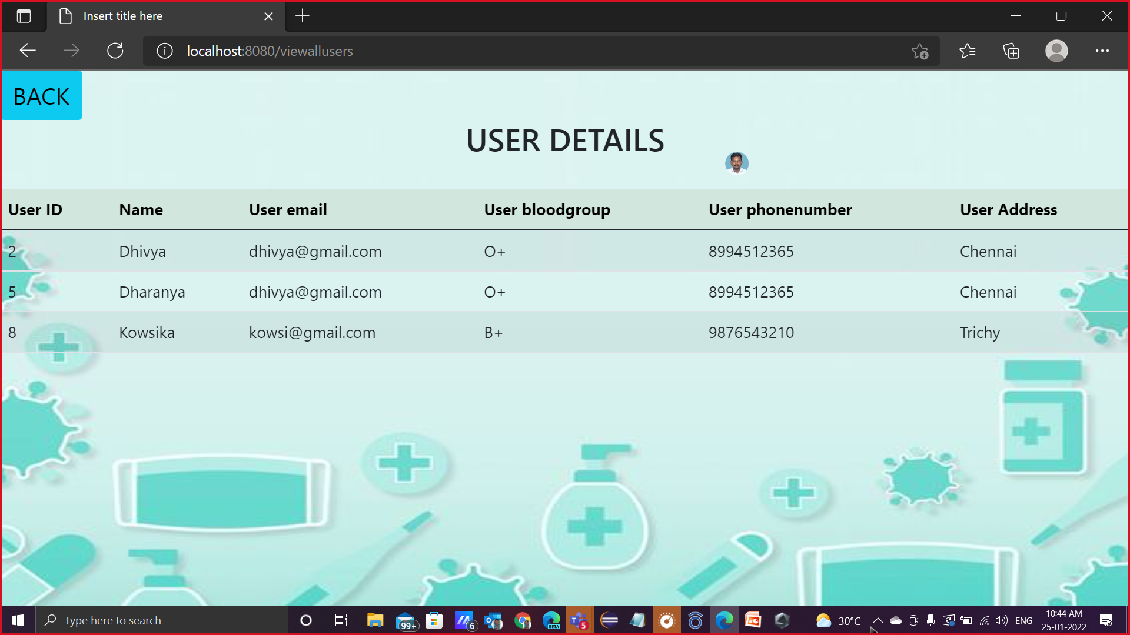

Slide 21
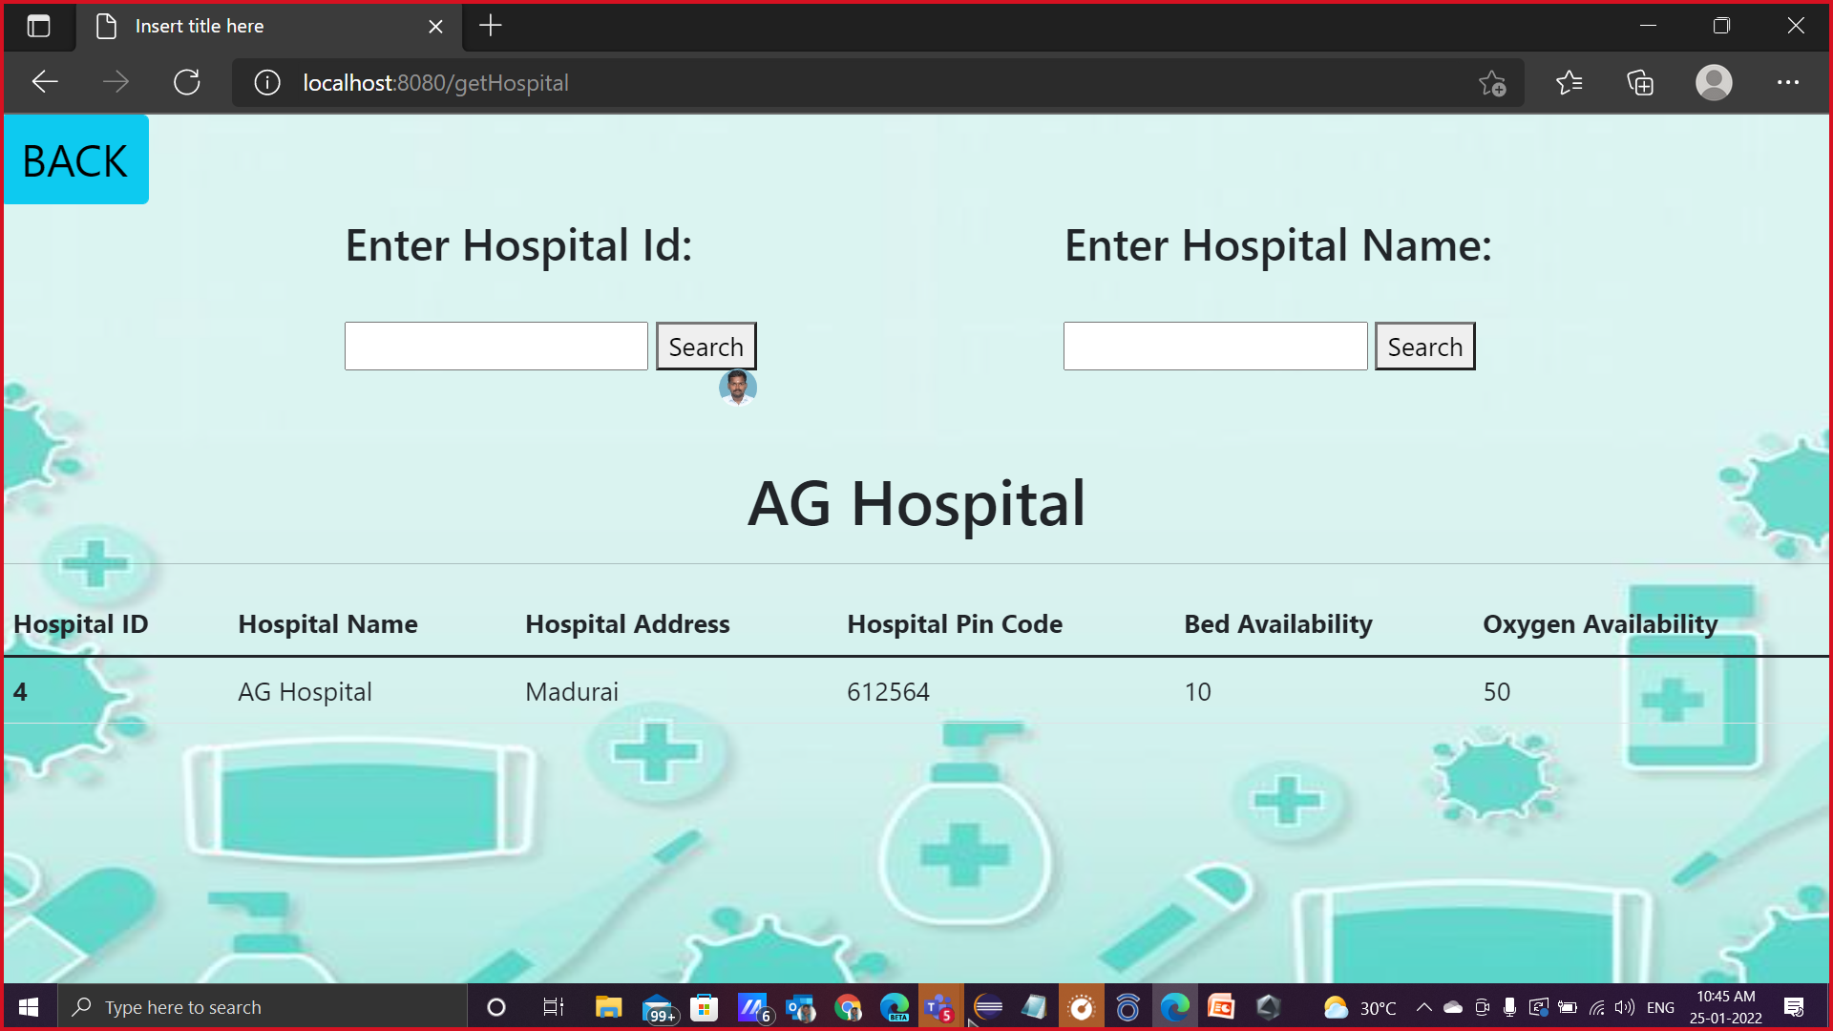

Slide 22
DOCTOR MODULE

Slide 23
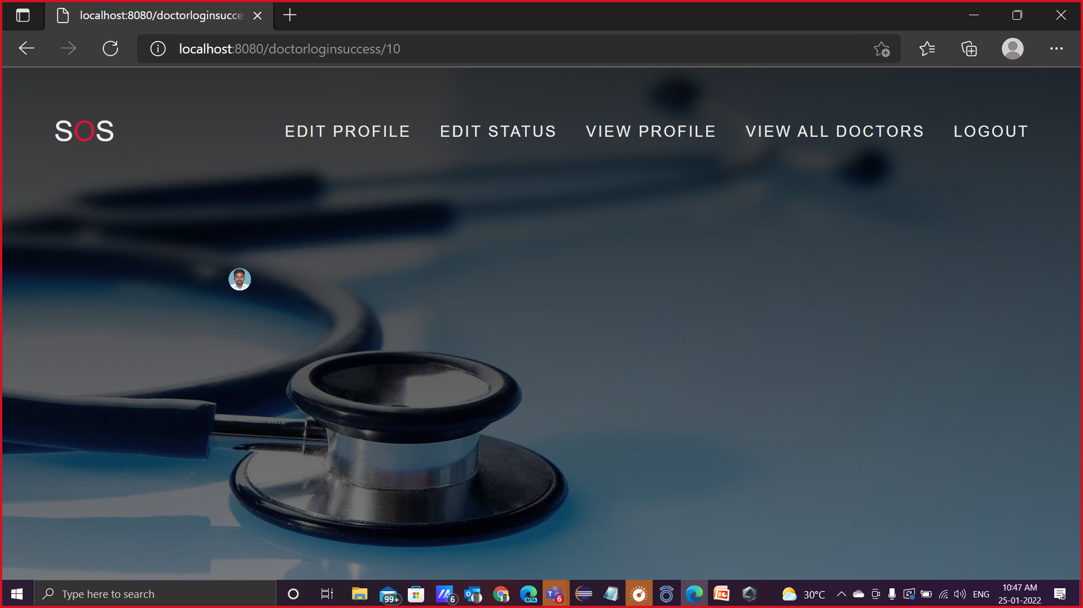

Slide 24
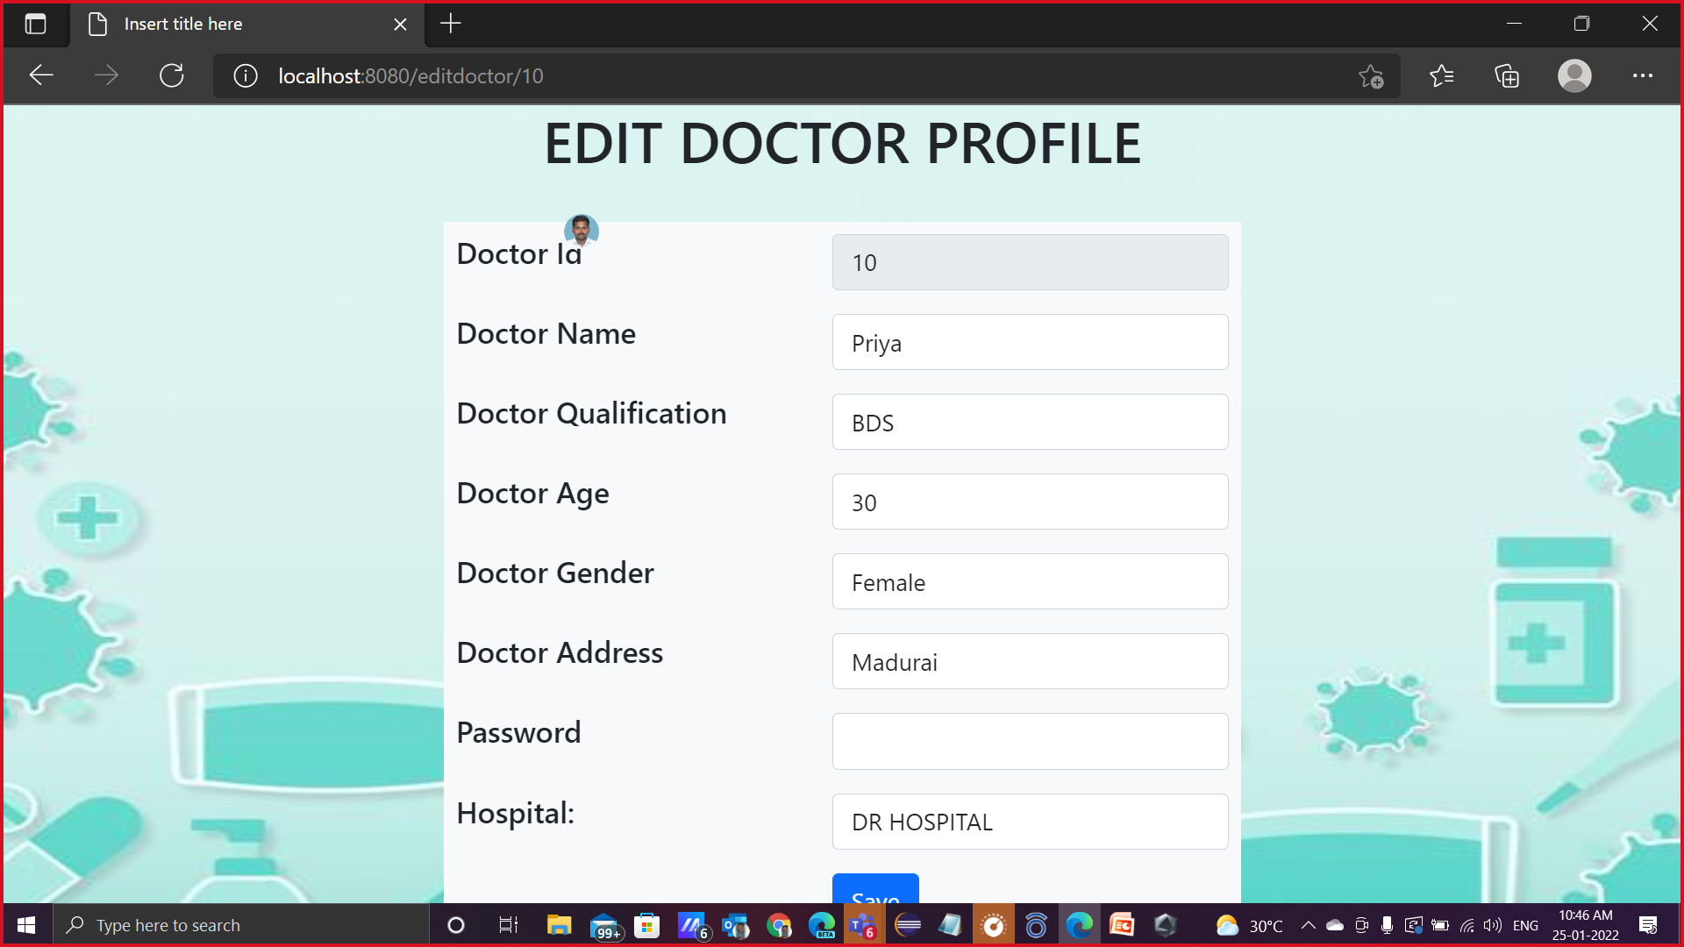

Slide 25
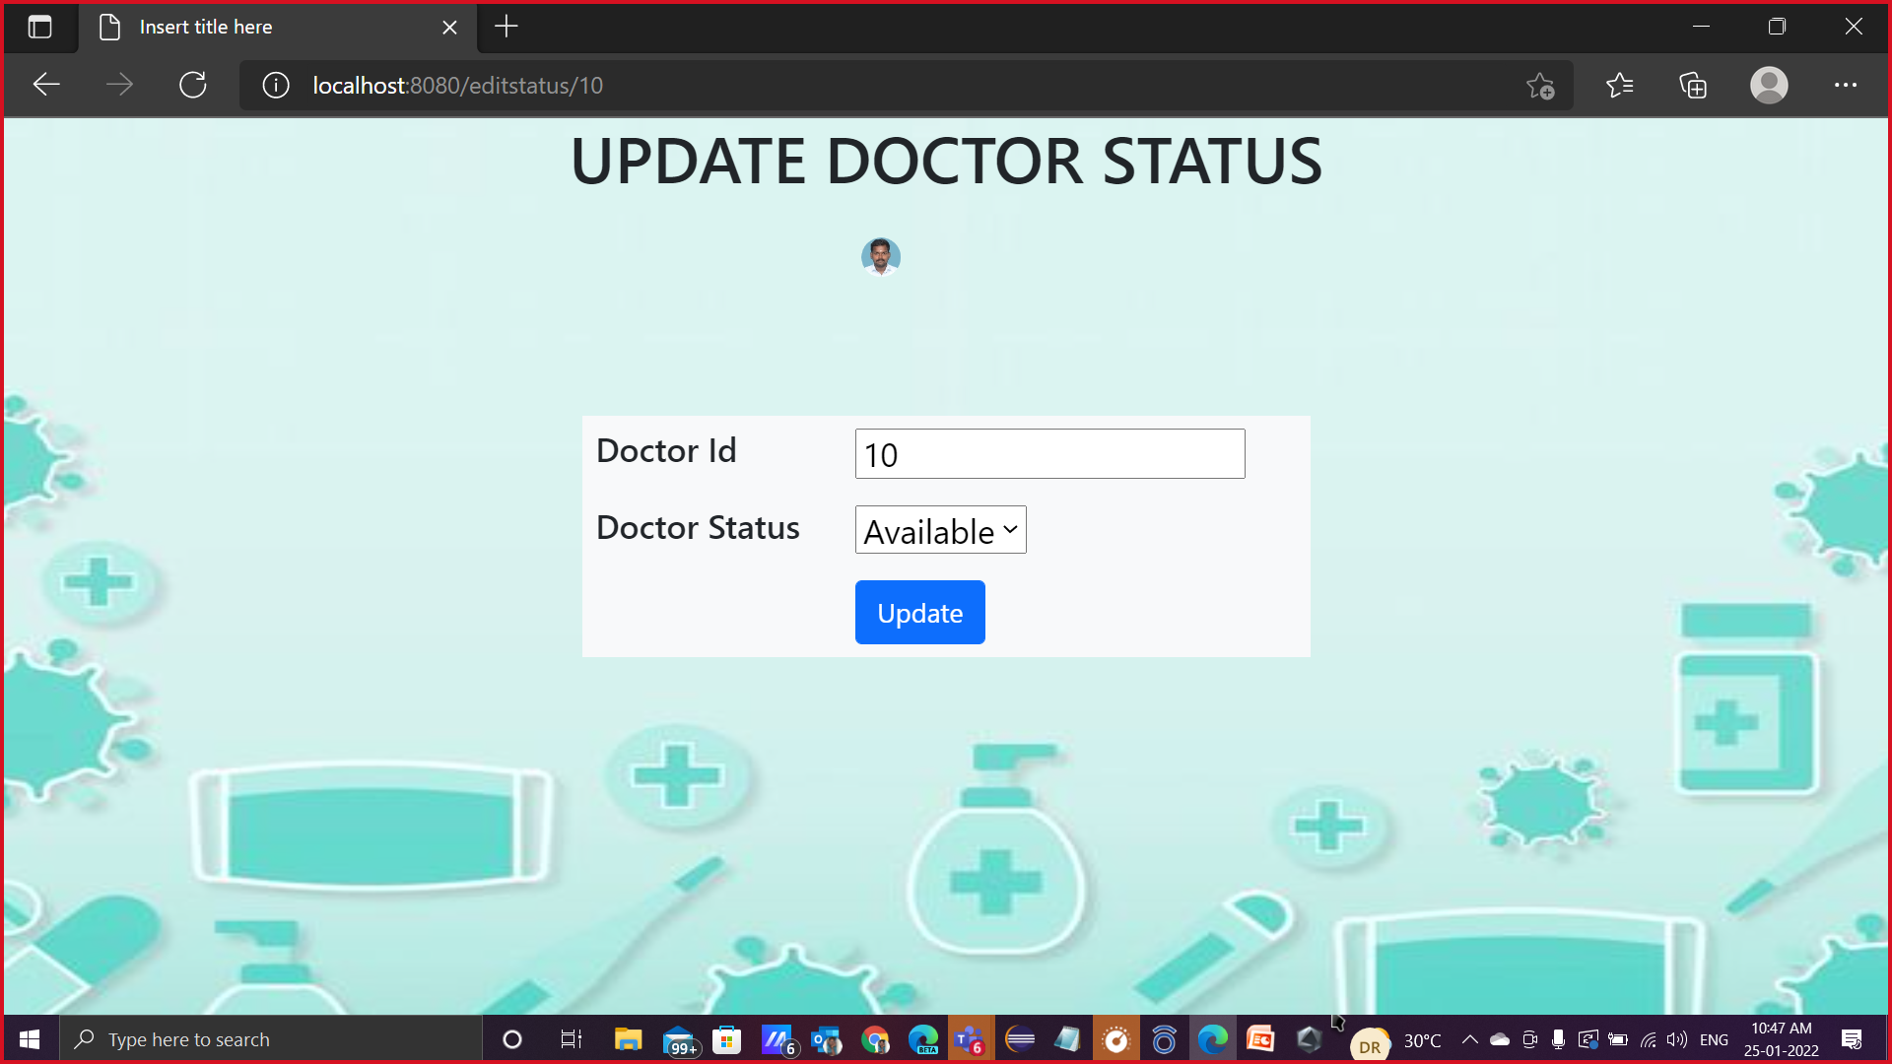

Slide 26
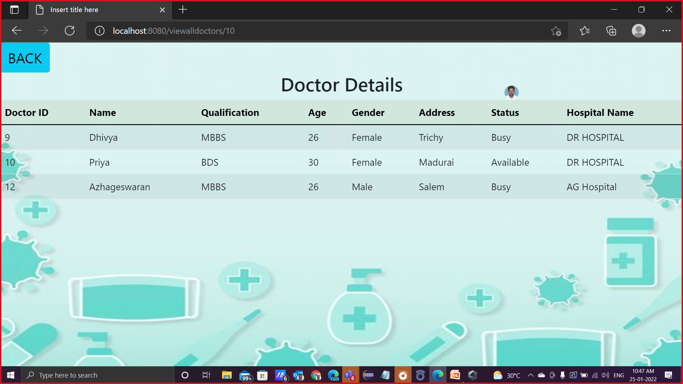

Slide 27
USER MODULE

Slide 28
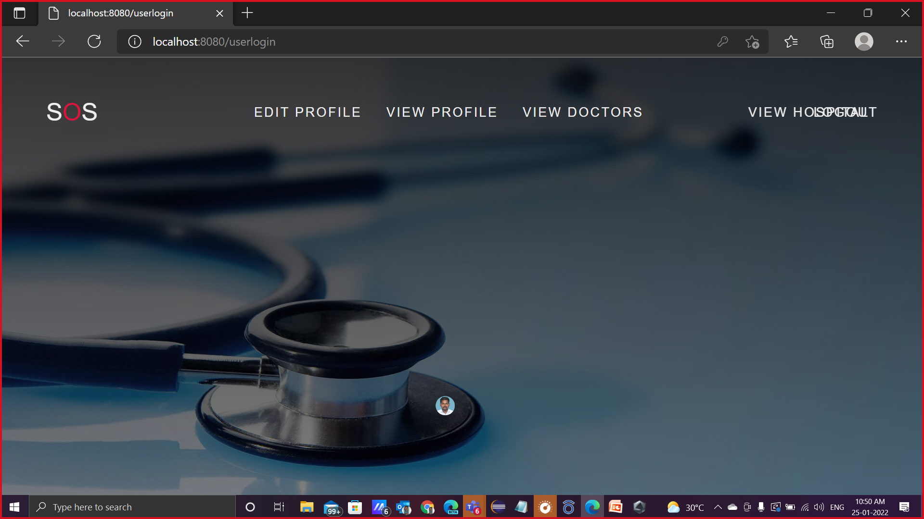

Slide 29
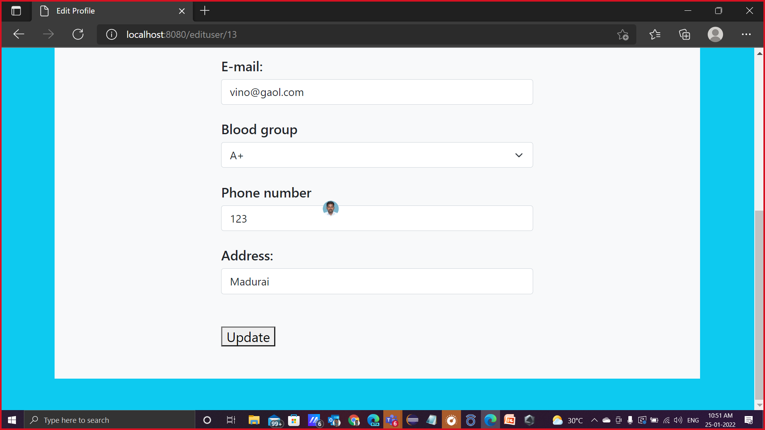

Slide 30
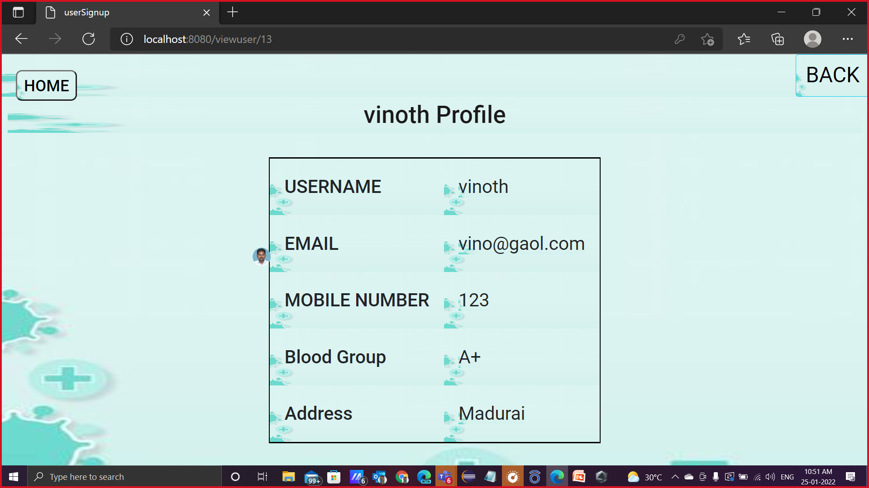

Slide 31
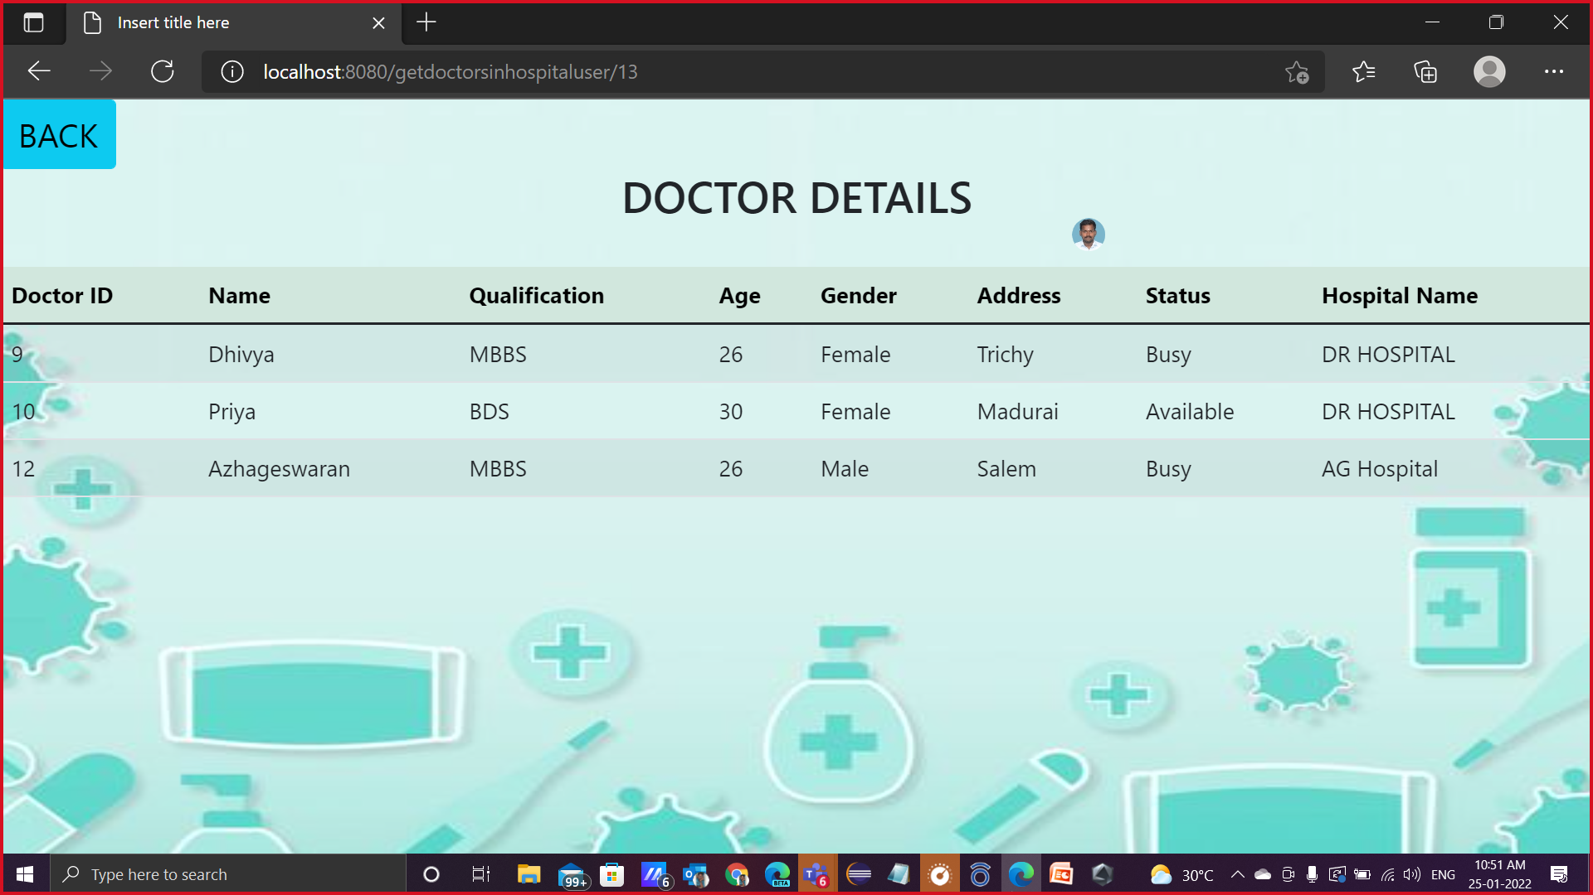

Slide 32
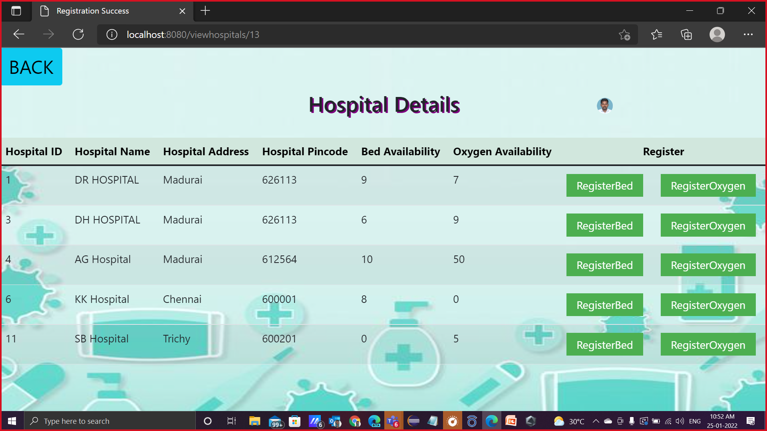

Slide 33
THANK YOU

